Slide 1
STATS C163 / C263 - Team Secret Agents
Autonomous
Reasoning Agent
A ReAct-based game-playing agent with reflection memory
and reasoning error localization
2
✓
Group: Warren Wu, Felipe Duenas, Sarthak Mohindru, Sayalee Damle

Slide 2
OVERVIEW
What We Built
General Purpose Reasoning Agent
Reflection Memory
Adapted Error Localization Framework
• Built on the Reasoning + Action (ReAct) framework. Thought -> Action -> Observation -> Decision
• Same agent brain across all games – only the game class changes
• Tested on Prisoner's Dilemma, Hunger Games, and Are You the Traitor?
• Every step logged as structured JSON - making reasoning fully auditable
Two memory layers:
• Within-game memory: round history injected into each new round's context
• Across-game memory: judge writes learnings to a persistent .md file, loaded automatically at the next session
• Two-layer memory = no repeated mistakes within a session or across sessions
• Adapted Xiaofeng's Tracer tool for reasoning-level errors
• An LLM judge audits the full reasoning trace after each game
• Localizes failures by round, step, and category -> suggests targeted fixes
• Lesson is written to persistent memory – agent plays measurably better next game

Slide 3
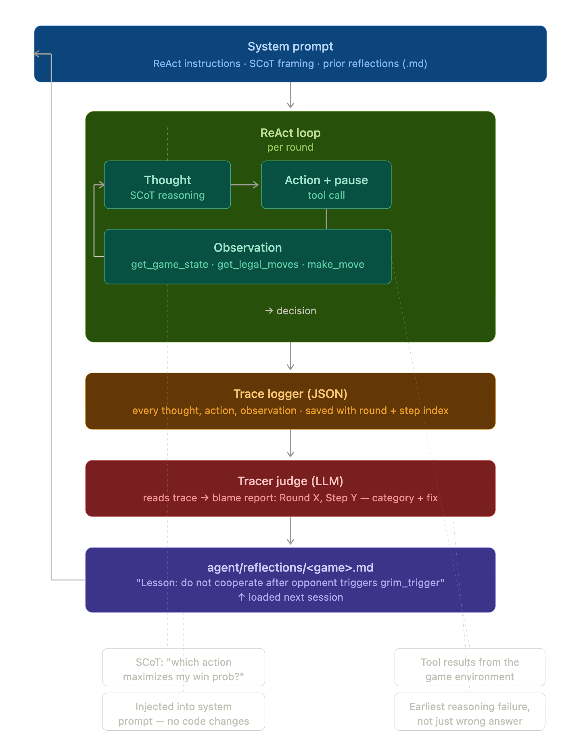
Agent Brain
Agent Architecture
Start from System prompt, including ReAct instructions & prior reflections
Enter ReAct Loop (with maximum iterations) with thought, reason, act, and observe steps
Trace Logger captures every step and stores it
Tracer Judge creates a blame report (LLM as a judge)
Lessons are written to a persistent reflections (.md) file for each game to prevent future mistakes

Slide 4




ERROR LOCALIZATION
Modified Error Localization Framework

Slide 5
ERROR LOCALIZATION
TRACE LOGGER
Structured Recording of every ReAct step
PER-STEP RECORD:
Round / Step Number
Prompt Sent To The Model
Raw Model Response
Parsed Thought / Action / Decision
Tool Observation
Game State Before & After
TRACER JUDGE
LLM Based Error Localization
FAILURE CATEGORIES:
Format error
State Error
Strategy Error
Tool Use Error
Illegal Name
Opponent Model Error
Goal Error

Slide 6
ERROR LOCALIZATION
How We Improved the Agent
BEFORE — Silent Bug Detected
AFTER — LLM Judge Localized the Error
Round 3 — Agent submits illegal move:
judge_trace.py output:
make_move: attack=6 defend=5 heal=0
→ REJECTED (6+5+0 = 11, not 10)
round: 3 category: "format_error" explanation: "attack=6 defend=5 heal=0 sums to 11" fix: "validate energy sum before submitting"
• Agent made an illegal move which violated the constraints of the game
• The agent retried and eventually made a valid move, so the game ran without crashing. Without inspection of the reasoning trace, this failure was completely invisible.
Reflection appended to hunger_games.md:
"Strictly validate all numerical constraints, especially sum requirements, at every step to prevent illegal moves."

Slide 7
REASONING GAMES
Verbal Reasoning-Based Games
Current Implementation
Prisoner’s Dilemma - (Axelrod (1984))
Hunger Games
Are You the Traitor? - (Costarelli et al. (2024))
Future Implementation for Tournament
Two Rooms and a Boom: Players are split into two rooms. Find your teammates, build trust, and exchange hostages before time runs out and the bomb explodes. (Costarelli et al. (2024))
Werewolf - (Xu et al. (2023))
Resistance / Avalon - (Light et al. (2023) AvalonBench; Lan et al. (2023))

Slide 8
Agent Testing
Game Constraints
Hunger_Game Constraints:
1. Allocate 10 points each round across:
Attack: deal damage to opponent
Defense: block incoming damage
Health: restore HP
2. Starting state:
Both players begin with 10 HP
Maximum 5 rounds
Choices are made simultaneously
3. Win conditions:
Opponent reaches 0 HP = immediate win
If both survive at round 5, player with higher HP wins
Skills Tested: strategic planning, opponent prediction, adaptation, and resource allocation under constraints
Prisoners Dilemma Constraints:
1. Each round, both players choose one action:
Cooperate: work together
Defect: betray opponent
2. Points per round:
Both cooperate = 3 / 3
You defect, they cooperate = 5 / 0
You cooperate, they defect = 0 / 5
Both defect = 1 / 1
3. Game format:
5 rounds total
Choices are made simultaneously
4. Win condition:
Player with the highest total score after 5 rounds wins

Slide 9
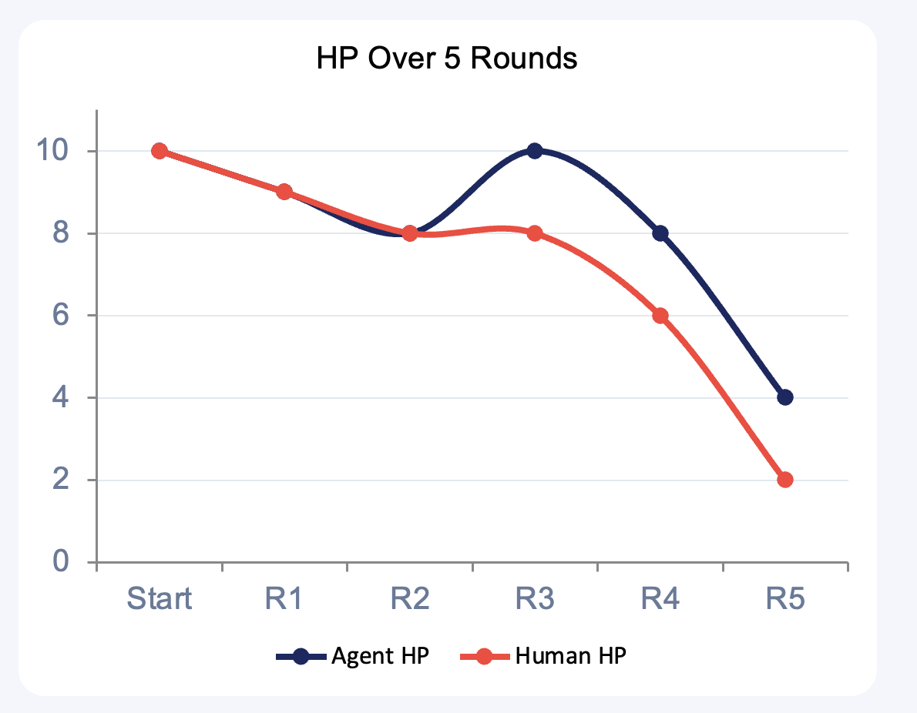
Agent Testing
Agent Reasoning Example — Hunger Games
Agent’s Key Decisions & Reasoning Traces Summarized:
R1
With no history, the agent chose a balanced opening (4,4,2) to test the human while protecting against early aggression.
R2
After observing a high-attack human move, the agent adapted by increasing defense (3,6,1) to reduce incoming damage while still applying pressure.
R3
The agent identified a repeated aggressive pattern and shifted to maximum survival (0,8,2), fully blocking the human's attack and restoring to full HP.
R4
With an HP lead, the agent avoided unnecessary healing and chose (4,6,0) to preserve its advantage while exploiting the human's low defense.
R5
Ahead on HP, the agent predicted a desperate all-in attack and selected (4,4,2) to absorb the hit and secure the win.

Slide 10
Live Demo
Demo 1 – Prisoner’s Dilemma, Agent vs. Agent
python games/pd_agent_vs_agent.py --rounds 5
Demo 2 – Hunger Games, Human vs. Agent
python games/hungergames_V1.py
Demo 3 - Are You the Traitor?, Agent vs Agent (multi-agent game)
Demo 4 – Strategic Error Localization and Across Game Reflection
python agent/judge_trace.py traces/******.json
Note: We are using GPT-4o for our demos
Current Implementation
Prisoner’s Dilemma - (Axelrod (1984))
Hunger Games
Are You the Traitor? - (Costarelli et al. (2024))
Future Implementation
Two Rooms and a Boom - (Costarelli et al. (2024))
Werewolf - (Xu et al. (2023); Zhu et al. (2023))
Resistance / Avalon - (Light et al. (2023) AvalonBench; Lan et al. (2023))

Slide 11
AGENT BEHAVIOR
Prompt Framing: Surprising Agent Behavior
One line of prompt change - completely different strategic behavior
Prompt Framing | Agent Behavior | Outcome
"Win at all costs" | Overly aggressive, ignores defensive play, chases wins recklessly | Lost winnable games
"Win, but avoid unnecessary losses" | Conservative and rational - secures draws when win not guaranteed | Better overall results
What happened: In our tests on Hunger Games, Prisoners Dillema and Are You the Traitor? under "win at all costs," the agent made an all-in attack chasing the win and lost a game it would have drawn.
Key takeaway: LLM agents are highly sensitive to how objectives are framed - not just what the objective is, but how it is worded.

Slide 12
Future Developments Planned
Testing Architectural Updates
Synthetic Data
Benchmark Testing
• Plug into Game Reasoning Arena for benchmarking.
• Testing agent in games that involve ‘talking’ to opponent agent before making a move
• Self-consistency sampling — run decision 3x, take majority vote (Wang et al.(2022))
• Tree of Thoughts — explore multiple move paths before deciding (Yao et al. (2023))
• LATS — Language Agent Tree Search for deep strategic lookahead (Zhou, A et al. (2024))
• Self-play data collection — two agents generate reasoning trajectories; Fine-tune on good trajectories

Slide 13
Summary
What We Built
What We Found
What's Next
General Purpose ReAct agent with 2 memory layers — same brain, any game
Prompt framing significantly changes strategic behavior
Testing agent on games involving agents talking to each other before making a move
Implemented and tested on Prisoner's Dilemma, Hunger Games, Are You the Traitor?
Two-level reflection memory (within game & across game) reduces repeated mistakes
Testing architecture updates mentioned on slide 12
Modified error localization framework with LLM as a judge to catch reasoning level errors
Plug agent into Game Reasoning Arena for benchmarking

